Slide 1
Space Qualification of the ICESat-2 Laser Transmitters
Fibertek, GSFC, and LGS Team

Slide 2
Laser Team Organization
GSFC
Risk Reduction & Requirements Verification
Fibertek
Flight Laser Design & Build
LGS Innovations
Reliability Analysis
Floyd Hovis | Ryan Edwards | Ryan Stevens | Liz Carrell
Nick Sawruk | Joe Rudd | Nigel Martin | Dave Moll
Ron Gustafson | Elias Fakhoury | Slava Litvinovitch | Xung Dang
Jim Bautch | Ted Wysocki | Joel Edelman | Gordon Seagraves
Chuck Culpepper | Fred Gore | Vincent Prisciandaro | Jim Phillips
Mike Albert | Ed Sullivan | Dave Wysocki | Rebecca Rexrode
Khoa Le | Abe Ibrahim | Pennie Drinkard | Tony Agront
Bridget Koloseus | Greg Witt | Bruce McIntosh | Hui Li
Kevin Andes | Jim Ochoa | Robert Krass | Maggie Gentzen
Steve Gerling | Maureen Murtagh | Stephanie Casey
Mark Stephen
Kathy Strickler
Elisavet Troupaki
Oleg Konoplev
Furqan Chiragh
Alex Vasilyev
Frankie Micalizzi
Demetrius Poulios
Al Piccirilli
Frank Nash
Leslie Reith
Tom Eltringham
Walt Slusark

Slide 3
System Overview

Slide 4
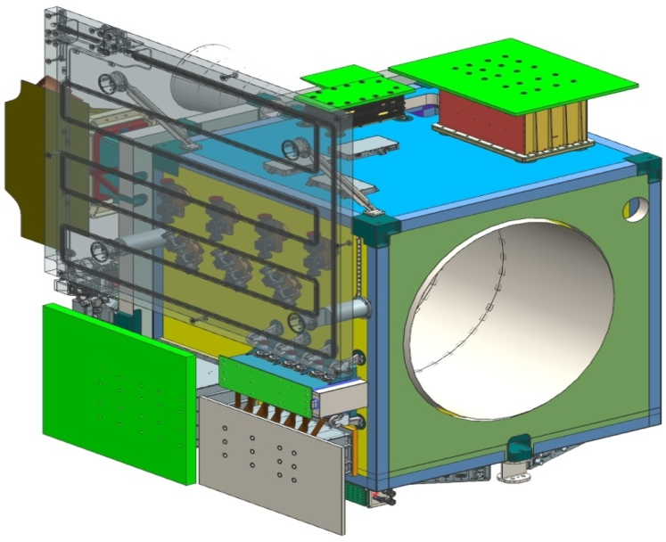
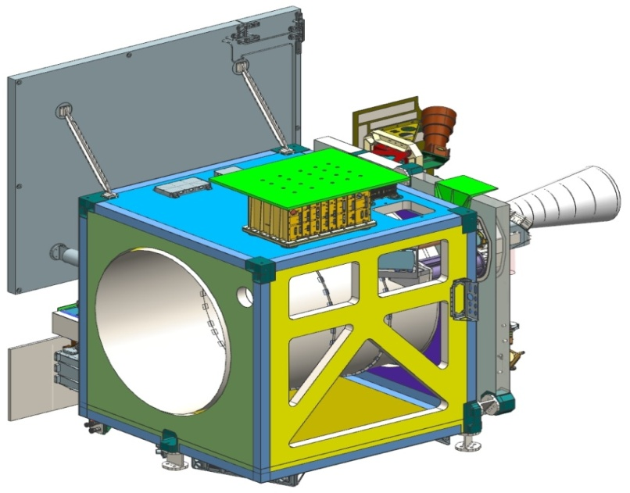
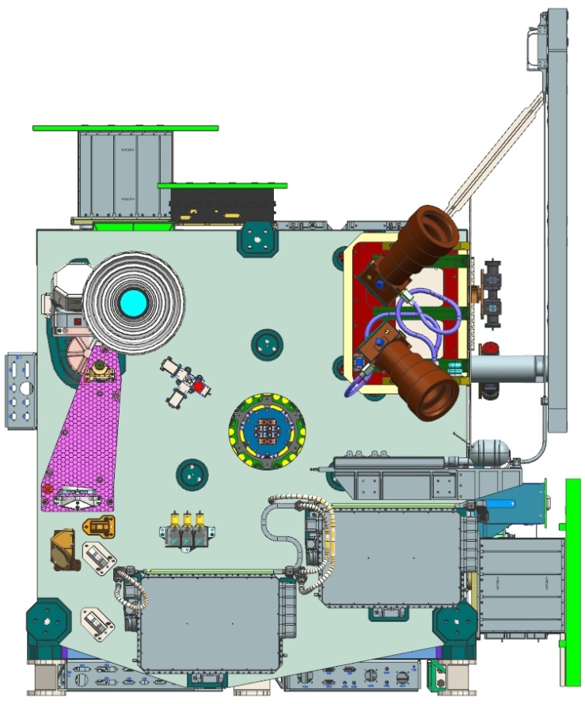
Instrument Views
Laser Radiator
Laser 2
Laser 1

Slide 5
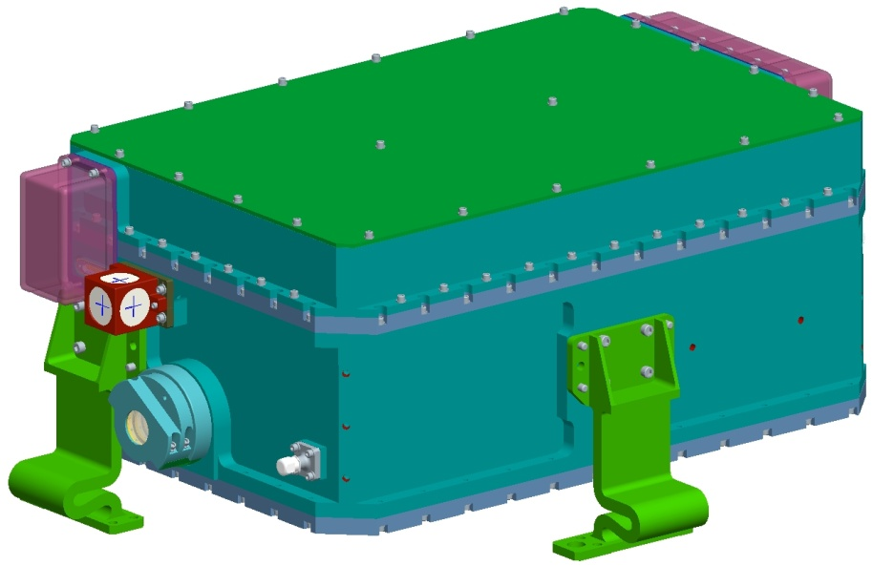
Flight Laser System Packaging Overview
LOM – Laser Optical Module
LEM – Laser Electronics Module
Integrated LOM/LEM with single thermal interface
  Mass < 21.6 kg
  <50 cm x 30 cm x 15 cm
  Robust to GEVS random vibe
Wavy flexure mounts
  Filters high-frequency content of GEVS 14.1 g_{rms} random vibe inputs
  Provides short-term & long term pointing stability
Dual compartment LOM with pressure insensitive center plane
  Allows air pressurization for long optical reliability
  Short term & long term pointing stability
LEM
LOM
Mounting Flexure (3x)
External alignment optics
Purge port (2x)
Packaging approach meets key mechanical driving requirements

Slide 6
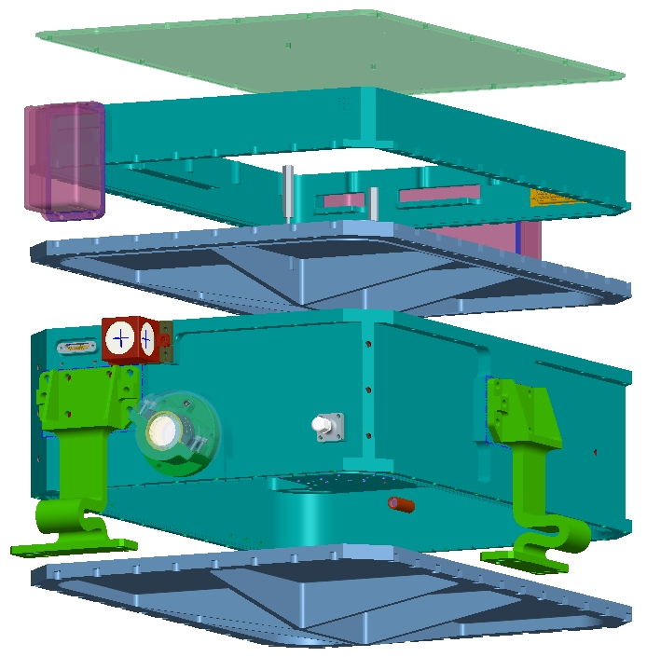
Mechanical Design Details
LOM – Laser Optical Module
LEM – Laser Electronics Module
Rib-stiffened & light weighted LOM lids
  Reduced pressure distortion of LOM center plane
Lightweight LEM structure with LOM lid mounted PCBs
  Mass < 21.6 kg
  Robust to GEVS random vibe
LEM Lid
LEM Wall
LOM Lid
LOM
Mounting Flexure 3x
LOM Lid
Packaging details enhance mechanical robustness and reduce weight

Slide 7
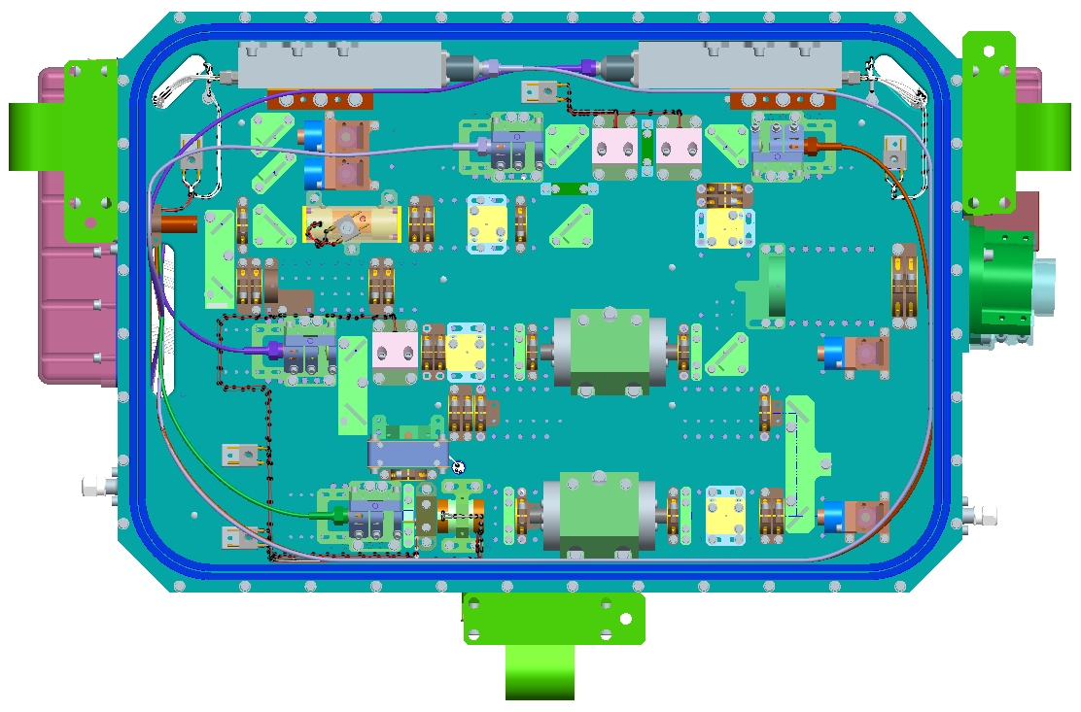
Flight Optical Configuration
Fiber-coupled diode pump modules
Short, electro-optic (E-O) Q-switched oscillator
  1.3 ns pulse width
  100:1 linear polarization
End-pumped gain medium
  M² ~ 1.3
  Supports >6% wall plug efficiency @ 532 nm
MOPA configuration
  250-900 µJ/pulse
LBO doubled Nd:YVO4
  532 nm
Internal telescope
  10 mm output beam
Diode pump modules
Power amp
SHG
Output telescope
Preamp
Oscillator
Frequency doubled Nd:YVO₄ MOPA achieves key optical driving requirements

Slide 8
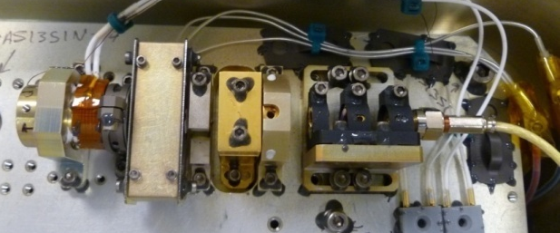
ICESat-2 ATLAS LASER Model History
Oct 2010
Jan
2011
April
2011
July
2011
Oct.
2011
Jan
2012
April
2012
July
2012
Oct.
2012
Jan
2013
April
2013
July
2013
Brassboard OSC #1
Build
Brassboard OSC #1
Life Tests
Brassboard OSC #1
Restarted Life Tests 12/2011
Brassboard OCS #2
Build
Brassboard OCS #2
Radiation Test
Brassboard MOPA#1
Build
Brassboard MOPA#1
Life Tests
BB MOPA#1
Redesign
Brassboard MOPA #1
Restart @20 kHz Life-Testing on 4/2012
Brassboard MOPA#2
Life Test Begins 11/2012
Brassboard MOPA#2
Build & Test
EDU#1
Build
EDU#1
Life Tests @ GSFC
EDU#1
Returned to Fibertek for evaluation
532 power decayed
Run-away thermal event on LBO & VBG ovens
Corrected faulty firmware on oven electronics
Keep electronics with updated firmware for EDU 3
EDU#2 long-term testing w/ external frequency doubling @ GSFC
EDU#2
Build
EDU#2
Performance testing
EDU#3 Empty box vibe tests 10/07/2011-10/31/2011 (includes rigid feet and flexure tests)
EDU#3 OSC. Build & Test 11/01/2011-11/22/2011
EDU#3 Amplifier Build/Test 11/23/2011-12/31/2011
EDU#3 TRL-6 Testing 1/1/2012-7/31/2012

Slide 9
Flow Chart for Current Best Estimate, Beginning Of Life Power
Chart below graphically illustrates the model used to used to estimate bus power needed to generate 9 W of 532 nm laser output
  Current MOPA optical to optical efficiency of 38% supports a wall plug efficiency to 532 nm of 6.5%
Overhead power is defined as total power output from the power board required for the control board, sensor board, Q-switch driver, energy monitor, pressure sensor, Volume Bragg Grating (VBG) heater, and second harmonic generator (SHG) heater
LEM
67 W total heat
LOM
80 W total heat
5.57 A
10W heat
QS
@28 VDC
12 W heat
EM
156 W
Power Conditioning
Board
Controller / Sensor
Board
5.0 W heat
7.0 W heat
6.0 W
PS
6.0 W heat
Reverse
protection
Eff = 75%
Interpoint DC/DC
16 W
150 W
27W
VBG
EMI filter
21 W heat
SHG
74 W heat
Eff =96%
118 W
4 W
Eff = 83%
6 W heat
Diode Power Board
OSC
Driver
AMP1
Driver
E to O
Eff =52%
O to O
Eff =32%
9.0 W
100 W
83 W
Eff =65%
900 µJ
Eff
=85 %
Diode
Pumps
MOPA
SHG
Preamp
Driver
AMP2
Driver
532 nm
10 kHz
18 W heat

Slide 10
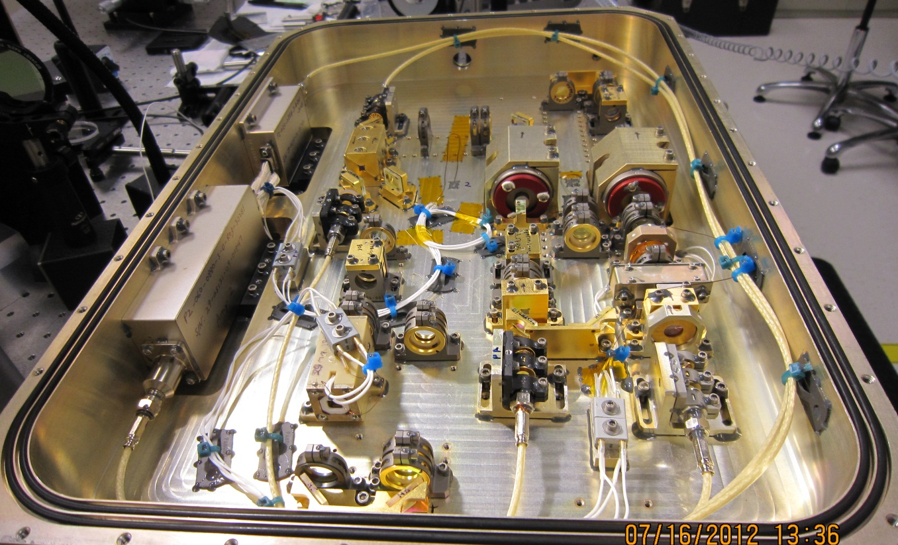
Flight Optical Design & Analysis

Slide 11
10,000 ft. Laser System Overview
MOPA Architecture (Master Oscillator – Power Amplifier)
  Nd:YVO₄ gain media
  All gain stages are end-pumped
  Diode pumps are 200 µm fiber coupled modules
Oscillator
  Bent linear cavity
  Volume Bragg Grating (VBG) output coupler – wavelength control
  Active (RTP) Q-switch
Pre-amplifier and dual power amplifier stages
  Single-pass slabs with undoped end caps
Frequency Doubler
  LBO (Lithium triborate – LiB₃O₅)
  Critically phased matched 3 cm crystal
~14X beam expander and external half-waveplate and wedge prisms for polarization control and beam steering will be added for flight

Slide 12
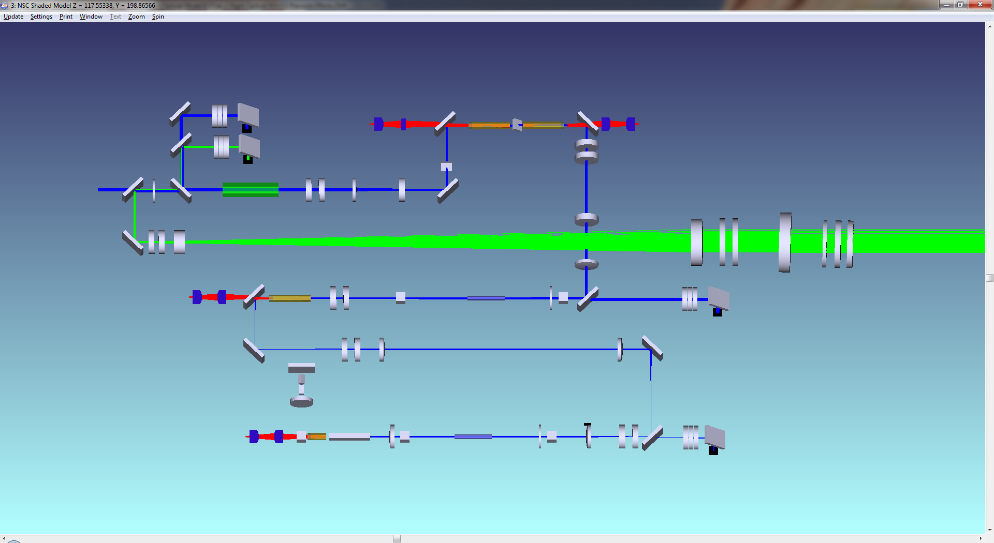
MOPA + SHG Power Scaling & Efficiencies
1.7 mJ @ 1 µm
O-O: 44%
1.1 mJ @ 532 nm
O-O: 65%
0.62 mJ @ 1 µm
O-O: 31%
0.19 mJ @ 1 µm
O-O: 31%
Optical to Optical (O-O) efficiency is defined as the ratio of extracted power to pump power
Optical efficiency to 532 nm is 25%, which supports the 532 nm wall plug efficiency requirement of > 5%
BB MOPA #2 prototype exceeds all required O-O efficiencies

Slide 13
Short Pulse Oscillator: Linewidth & Wavelength Tuning
VBG wavelength specification (Air)
  1063.92 ± 0.120 nm @ 22°C
  Between 1063.80 nm and 1064.04 nm @ 22°C
  Tuning rate 10-15 pm/°C
Target oscillator wavelength (Air) 1064.25 nm and 532.125 nm
  VBG operating temperature of 36°C to 75°C
Typical 532 nm linewidths are < .010 nm
  > 95 % transmission through the etalon assuming perfect laser / etalon overlap
  > 85 % transmission with a 16 pm laser / etalon mismatch using worst case experimental spectral data
Oscillator must tune over a 50 pm range with ≤ 2.5 pm steps
Experimental data from EDU-2 laser system demonstrated >85% etalon transmission and tuning over > 50 pm in ≤ 2.5 pm steps
Notes:
Add etalon transmission data from GSFC in new slides

Slide 14
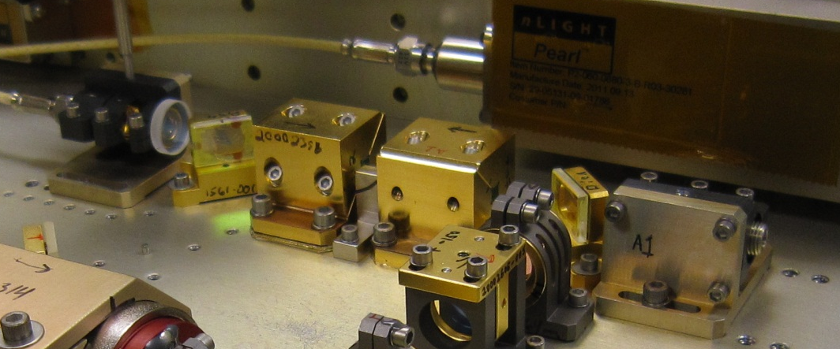
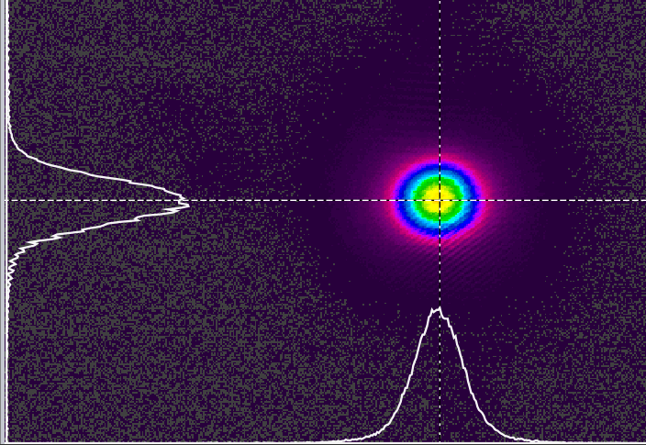
Amplifier: 1064 nm Experimental Results
Brassboard MOPA #2: Complete MOPA + SHG system also built with flight like optics and mounts
  Co-linear pump and signal alignment allows for maximum extraction from the amplifier, resulting in higher system efficiencies
Amplifier Far-Field
Brassboard MOPA #2
O-O 1 µm efficiency 38%, compared to a derived requirement of > 27%

Slide 15
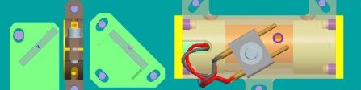
Frequency Doubler
Critically Phased Matched
LBO
Harmonic
Separator
Harmonic
Separator
Critically Phased Matched
LBO
Pick-Off
Sampler
Frequency doublers design
  30 mm LBO crystal
    Longer conversion length → lower fluence while still meeting a > 65% conversion efficiency
    Highest quality LBO, screened for ultra high homogeneity
  High quality optical components
    All 532 nm optics have a LDT safety factor of > 7x
Flight design addresses identified risks, enables driving requirements, has been demonstrated on Brassboard MOPA #1 and will be demonstrated on Brassboard MOPA #2

Slide 16
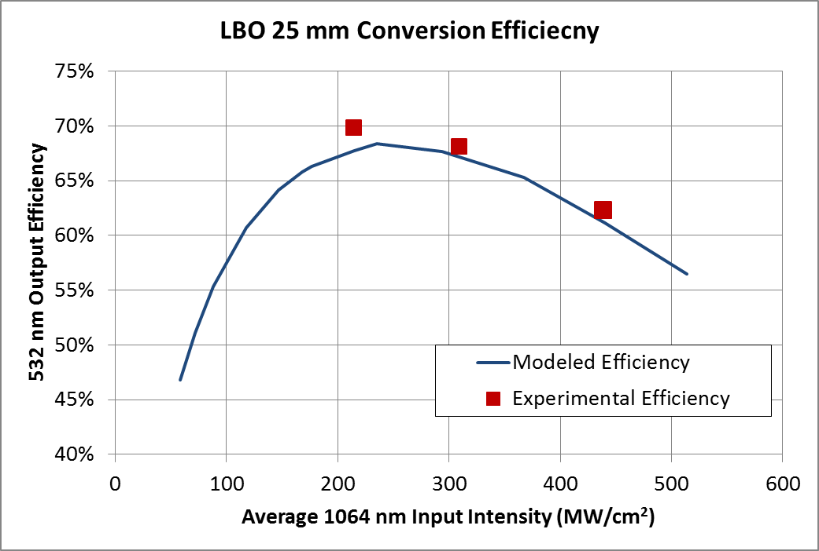
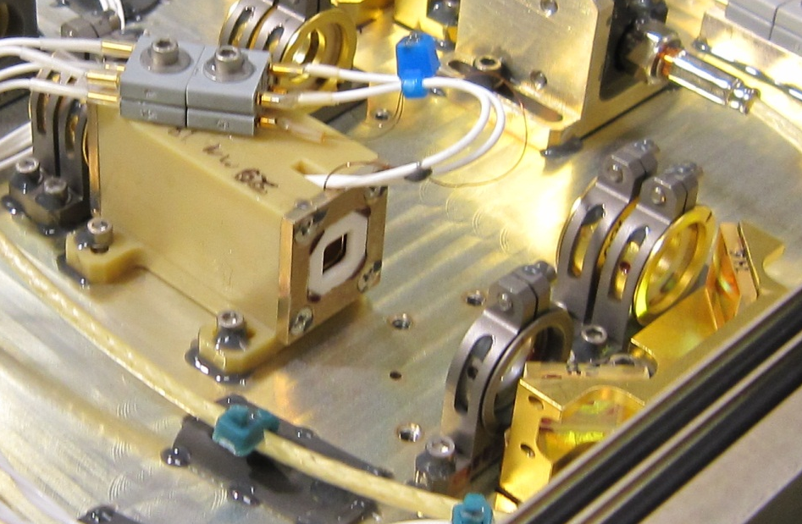
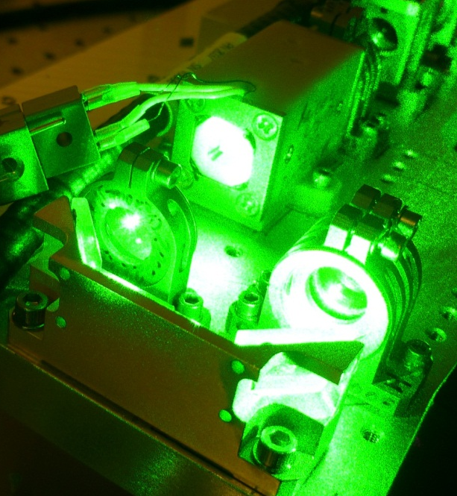
Frequency Doubler: Experimental Results
Numerous systems built with SHG efficiencies of > 65% and M² < 1.4
SNLO SHG model correlates well to experimental results from Brassboard MOPA #1 and EDU-3
Flight LBO will be 30 mm in length, allowing for a further reduction in operating fluence and maintaining a > 65% conversion efficiency

Slide 17
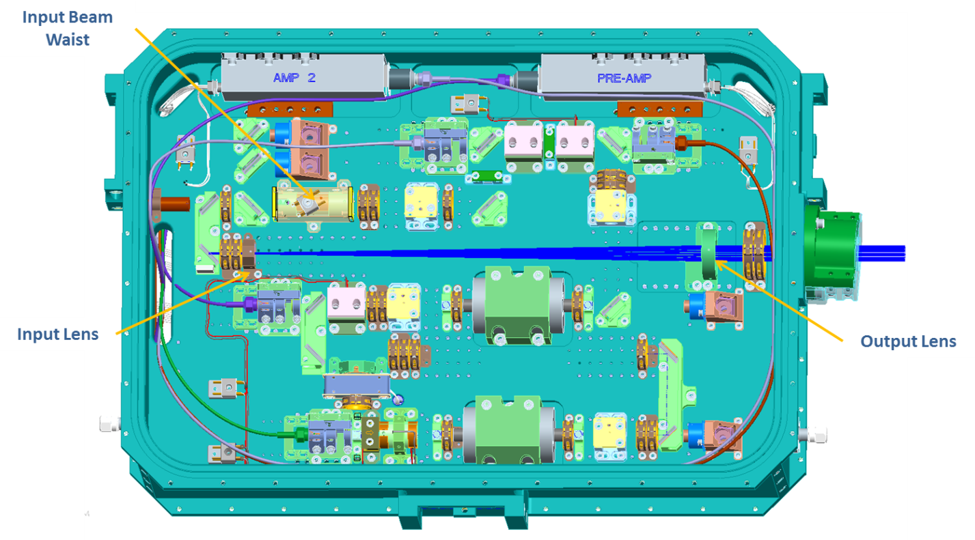
Beam Expander
Beam expander design
  Refractive beam expander provides a compact design
    Meets divergence requirements over the full pressure range (18 PSIG to VAC)
  High quality optical components
    All beam expander components have a LDT safety factor of > 10x
Design addresses specific risks and will be demonstrated on Brassboard MOPA #2

Slide 18
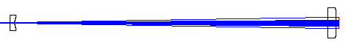
Beam Expander: Design
285.57mm
11.243”
25.4 mm
1”
12.7 mm
0.5”
❷
❶
Input Beam
Mixed Mode Beam Waist (mm) | 0.70
M² | 1.4
Full Angle of Divergence ( mrad) | 1.35
Beam Waist to the 1st lens (mm) | 113
Output Beam | Average | Derived Spec
Beam Size (mm) | 9.74 | ≤10
M² | 1.4 | <1.6
Full Angle of Divergence (μrad) | 97.4 | ≤108
Beam Waist (mm) | 9.74 | ≤10
Beam Waist to the last surface (mm) | 1002 | NA
The beam expander is a very simple Galilean telescope design. A family of input lens ROCs were designed to accommodate subtle differences of input beam diameters while maintaining the same output beam-size from laser to laser.

Slide 19
Beam Expander: Air Pressure vs. Divergence
Air Pressure (ATM) | Beam Div. (Full, µrad) | Div. Δ | % change | Beam Waist (mm) | Beam Waist Location to the last lens (mm) | Beam Size at Telescope Output (mm)
1 | 97.41 | 0 | 0% | 9.735 | 1112 | 9.736
0.75 | 97.54 | 0.13 | 0.13% | 9.722 | -5480 | 9.737
0.5 | 98.09 | 0.68 | 0.70% | 9.668 | -11939 | 9.738
0.25 | 99.06 | 1.65 | 1.69% | 9.573 | -18104 | 9.739
0 | 100.44 | 3.03 | 3.11% | 9.442 | -23841 | 9.741
The beam expander design meets the system divergence requirement over the full operating pressure range

Slide 20
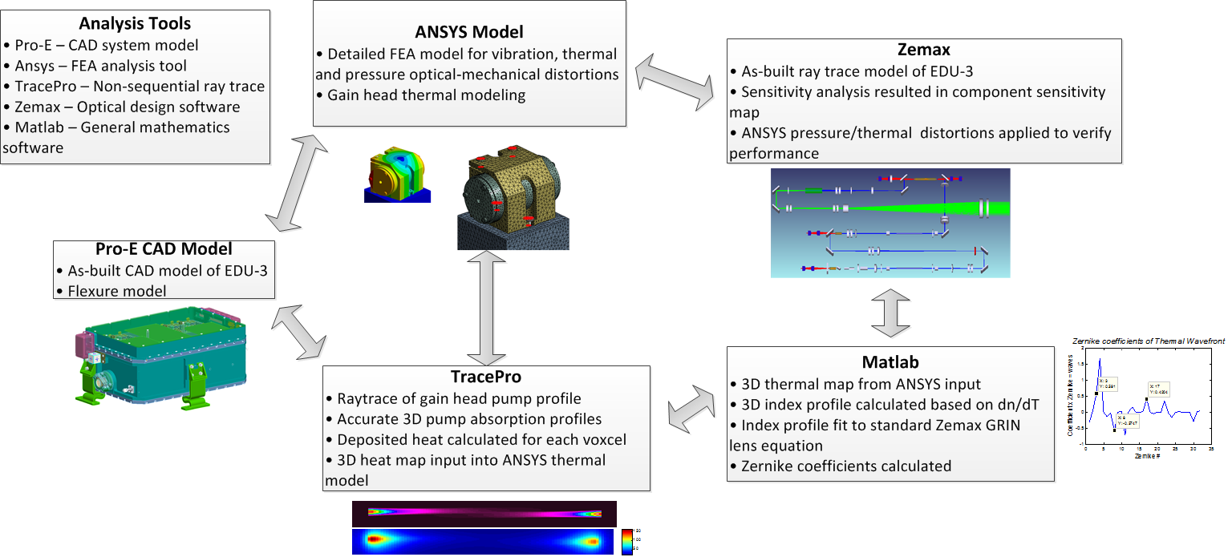
STOP Analysis
Structural Thermal Optical (STOP) analysis

Slide 21
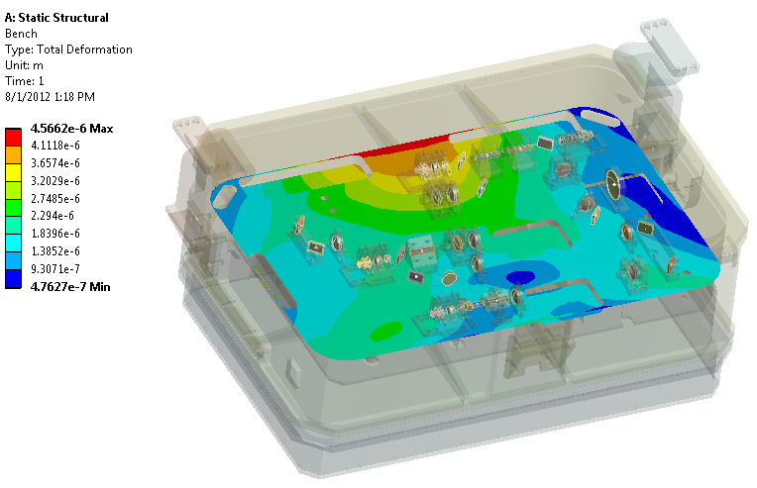
STOP Analysis: Pressure 18 PSIG
Rotations and displacements of key opto-mechanical components are tracked in an FEA model (mirrors, lens, fiber coupled pumps, etc.)
Rotations and displacements are applied to the optical model and beam points and displacements are modeled with a worst case pressure delta of 18 PSIG (BOL)
  Over the mission life the pressure delta will decrease and alignment will return to the as-built alignment
  Signal beam displacement delta under vacuum: 320 µm (requirement < 2,000 µm)
  Signal beam pointing delta under vacuum: 60 µrad (requirement < 60 µrad total)
Results agree well with the TRL-6 testing measured boresight shifts under vacuum (no beam expander) of 50 µrad compared to the model result of 35 µrad
Analysis supports requirement of < 60 µrad shift for an 18 psi differential (complete LOM depressurization)

Slide 22
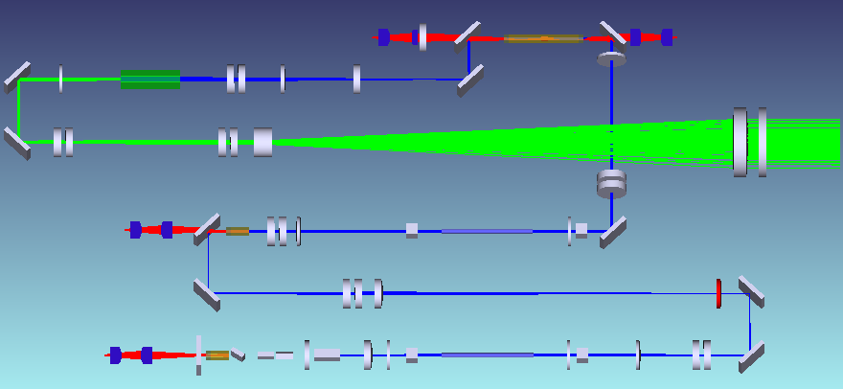
STOP Analysis: Sensitivity Map
DECHIPHER KEY
D: Displacement @ input to output beam expander
  µm of displacement per µrad of component rotation OR
  µm of displacement per µm of component motion
B: Boresight at input to final beam expander
  µrad of boresight per µrad of component rotation OR
  µm of boresight per µm of component motion
SM: Slippage safety margin based on friction only
D: 0.4 µm / µrad
B: 0.1 µrad / µrad
SM: 10
D: 0.2 µm / µrad
B: 0.1 µrad / µrad
SM: 10
D: 0.3 µm / µrad
B: 2 µrad / µrad
SM: 6
D: 1 µm / µm
B: 2 µrad / µm
SM: 16
D: 6 µm / µm
B: 12 µrad / µm
SM: 16
D: 0.3 µm / µrad
B: 0.5 µrad / µrad
SM: 10
D: 9 µm / µm
B: 25 µrad / µm
SM: 16
D: 0.1 µm / µrad
B: 0.1 µrad / µrad
SM: < 1
D: 0.2 µm / µrad
B: 0.9 µrad / µrad
SM: 10
D: 0.3 µm / µrad
B: 0.6 µrad / µrad
SM: 6
D: 9 µm / µm
B: 25 µrad / µm
SM: 16
D: 15 µm / µm
B: 32 µrad / µm SM: 16
D: 0.1 µm / µrad
B: 0.1 µrad / µrad
SM: < 1
D: 0.2 µm / µrad
B: 0.4 µrad / µrad
SM: 6
D: 11 µm / µm
B: 21 µrad / µm
SM: 16
D: 3 µm / µm
B: 7 µrad / µm
SM: 16
Optical sensitivity analysis combined with the structural analysis shows the laser design meets the criteria to successfully operate over the mission environments

Slide 23
STOP Analysis Summary
Environmental test data and the STOP analysis show consistent results
STOP analysis results were used to determine the system’s most sensitive optical components to be liquid pinned
Beam pointing experimental and analysis results are consistent with the TAR beam pointing allocations

Slide 24
Laser Risk Reduction Activities
Lessons Learned
Risks
  Components that have not flown in space
    Radiation testing
    Q-Switch life testing
  Frequency Doubler – LBO
    Corrective action plan from PDA
  Optics (Optical Damage)
    LIDT review
    Spectral Mode Analysis
    Life testing
  Diode Laser Pump Modules
    Qualification plan
    Life testing
System life-testing
  Brassboard oscillator #1
  MOPA-1 10 kHz testing
  MOPA-1 20 KHz
  EDU 1,2
System qualification testing
  GEVS level random vibration testing of EDU-3
  GEVS level thermal/vacuum testing of EDU-3
  Radiation testing of Brassboard Oscillator #2
Notes:
Remove first bullet, add a Summary slide…Mark

Slide 25
CALIPSO Lessons Learned Applied to ICESat-2 Laser Design
Implemented
Implemented
Implemented

Slide 26
Lessons Learned
ICESat-2 Lifetime and TRL-6 Testing
Lesson 1 – Rigidly mounted laser modules can experience excess internal stresses under GEVS level random vibration due to structural resonances
  Implemented wavy flexure mount design in TRL-6 and flight systems to filter frequencies at the laser module resonant frequencies
Lesson 2 – High gain of Nd:YVO₄ coupled with the temperature of RTP Q-switch makes maintaining hold-off difficult in a short, end-pumped, straight linear resonator
  Changed flight design to a bent linear resonator to prevent residual 880 nm pump light from non-uniformly heating RTP Q-switch
Lesson 3 – Trillion shot lifetime lasers are more sensitive to long term optical degradation than previous billion shot class missions
  Flight systems will use the highest damage threshold coatings available. Special attention will be given to contamination control (cleaning procedures & getters). A good understanding/model of intra-cavity fluences has been developed.
Lesson 4 – Small debris (such as Kapton tape) is easily hidden in a complex optical cavity
  Rigorous Foreign Object Detection procedures all stages of build is being implemented
Lesson 5 – Detailed & accurate build documentation is critical for flight missions
  Build documents are being revised & reviewed by Fibertek and GSFC. Employee awareness training on flight hardware builds will be conducted.

Slide 27
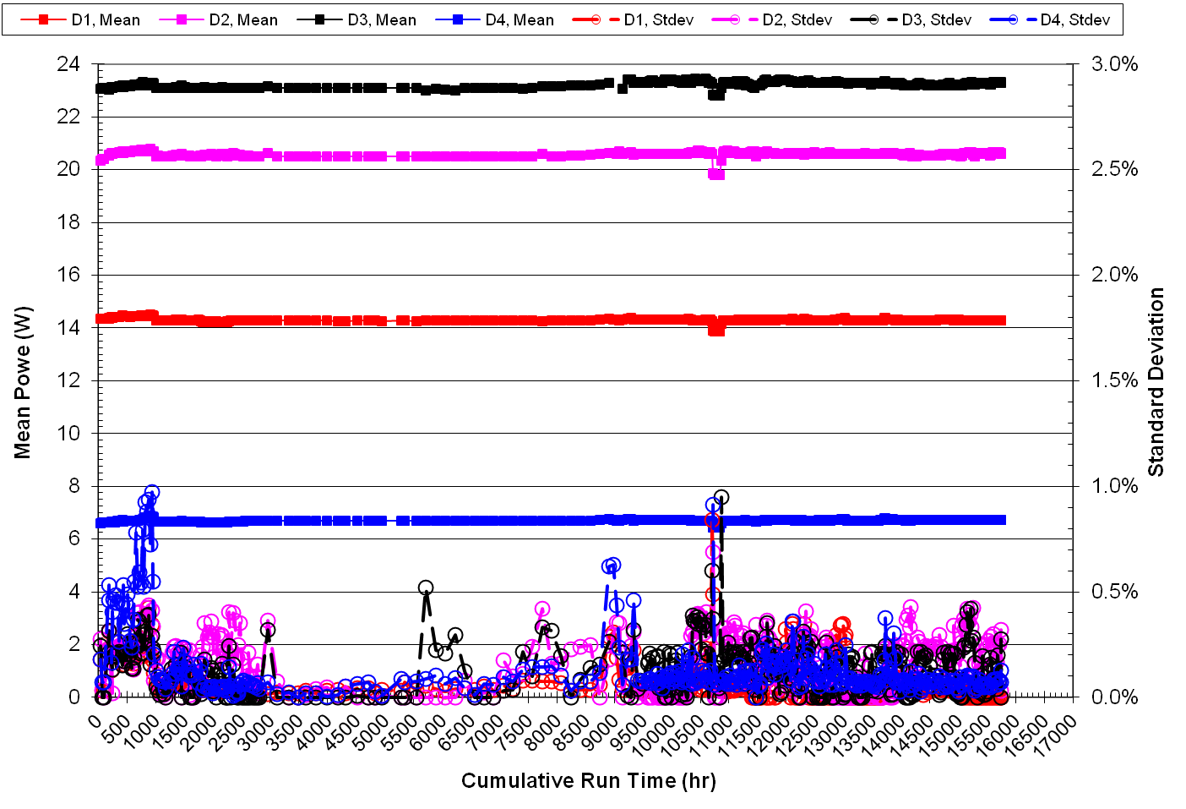
Pearl Module Life Testing at Fibertek
4 Pearl life test modules
  Module average power is continuously measured and processed weekly
    Power data is collected every 10 seconds
    Power data is averaged every 24 hours
    STDEV of each 24 hour window is used as the error bars
    Data is plotted with one data point for each 24 hour window
    Raw data is archived
  All modules running at 10 kHz with a cold plate temp of 23°C
  Nominal operating conditions are 10 kHz, 30-35 % duty cycle & 4-8 A peak current
  2x 6-chiplet module (20 W)
    6.7 W average power, 30 % duty cycle, 4 A peak current
    14.3 W average power, 35 % duty cycle, 8 A peak current
  2x 16-chiplet modules (60 W)
    20.6 W average power, 33 % duty cycle, 5 A peak current
    23.3 W average power, 33 % duty cycle, 5 A peak current
No measurable degradation after 15,800 hours of run time (57% of mission life)

Slide 28
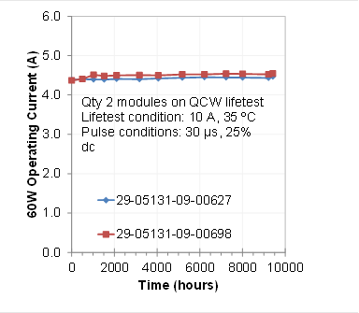
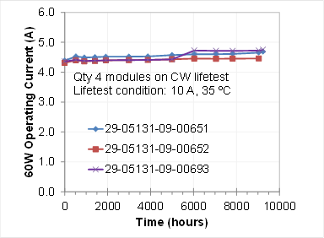
Pearl Module Life Testing at nLight
Accelerated nLight Life Testing (5 modules) – Updated 7-20-2012
  Modules characterized every 2000 hours
  2x 16-chiplet modules (60 Watt)
    10 kHz, 25% duty cycle, 10 A peak current, 35-40 C thermistor temp
    No measurable power drop
  3x 16-chiplet modules (60 Watt)
    CW operation, 10 A average current, 35-40 C thermistor temp
    Module 00693 appeared to have a chiplet failure at 6000 hours, other two unchanged
  6 additional modules will be added to the life testing at nLight 2nd quarter 2013

Slide 29
Pearl Module Life Testing at GSFC
GSFC life testing is being done CW at 20 W for 6 emitter modules and at 60 W for 16 emitter modules
Results to date are consistent with ICESat-2 laser lifetime requirements
Overview of Modules Under Test
TDK-Lambda
GEN60-25
nLight 20W
p2-020-0880-29-05109-10-02879 (Reference)
nLight 20W
p2-020-0880-29-05109-10-02898
[Vibration Tested]
nLight 20W
p2-020-0880-29-05109-10-03139 [Vibration Tested]
TDK-Lambda
GEN150-15
nLight 60W
p2-060-0880-29-05136-09-00906 (Reference)
nLight 60W
p2-060-0880-29-05136-09-00846 [Vibration Tested]
nLight 60W
p2-060-0880-29-05136-09-00951 [Vibration Tested]
nLight 60W
p2-080-0880-29-05131-09-00696 (Stock Unit)
TDK-Lambda
GEN60-25
nLight 20W
p2-020-0880-29-05109-10-02879 (Reference)
nLight 20W
p2-020-0880-29-05109-10-02898
[Vibration Tested]
New Units Added 6-20-2012
GSFC testing of 9 pump modules at full CW power ratings supports the mission lifetime requirement

Slide 30
nLight Pearl Module Life Testing
A significant sample of Pearl Modules being life tested under various nominal and accelerated conditions show good performance
  3 modules being tested at Fibertek under flight-like pulsed conditions (10 kHz, 33% duty cycle, 4-5 A drive current) show no measureable (<2%) degradation after >15,800 hours
  1 module being tested at Fibertek under accelerated pulsed conditions (10 kHz, 35% duty cycle, 8 A drive current) shows no measureable (<2%) degradation after >15,800 hours
  Two modules being tested at nLight under accelerated pulsed conditions (10 kHz, 25% duty cycle, 10 A drive current) show no measurable degradation after >9,000 hours
  Two of three 16- chiplet modules in accelerated CW life testing at nLight (10 A average current, 35-40 C thermistor temp) show stable performance with no signs of degradation after >9000 hours
    One module appears to have had a singlet chiplet failure at 6000 hours. Module is still functional and would meet ICESat-2 mission requirements.
  7 modules being tested at GSFC show stable after 4000 hours
  2 additional 20 W modules have recently been added to the GSFC testing
A total of 20 dedicated life test modules will be on line by 2nd quarter 2013
An additional 9 modules will be life tested in laser transmitter systems (BB-MOPA #2, BB OSC #2, SN-1, etc.)

Slide 31
System Level Life-testing

Slide 32
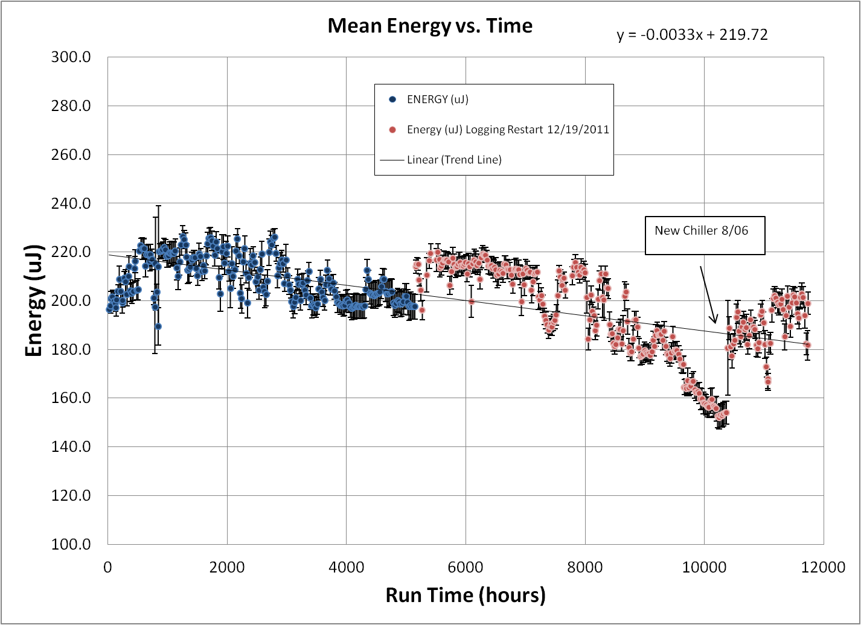
Life Test Oscillator Total 1064nm
After changing chillers the oscillator output has stabilized to ~200 uJ
  Output variability seems to be humidity related
  Humidity monitoring is being implemented to quantify effects of humidity on output energy

Slide 33
Original Brassboard MOPA 1
Green Power Decay Data
RCCA activity completed and report submitted
  Negligible loss of 1064 nm power
  75% of power drop due to loss of hold-off in oscillator
  25 % of decay to damage on LBO output face
  Corrective actions implemented for flight design
    Bent oscillator to improve hold-off
    Reduced fluence on LBO
    More stringent contamination control and incorporation of getters
Notes:
Each data point is the average of a 24 hour window (8000 points). The error bars are +/-stdev of each 24 hour window (8000 points). The DAQ took 8000 points per 24 hours.

Slide 34
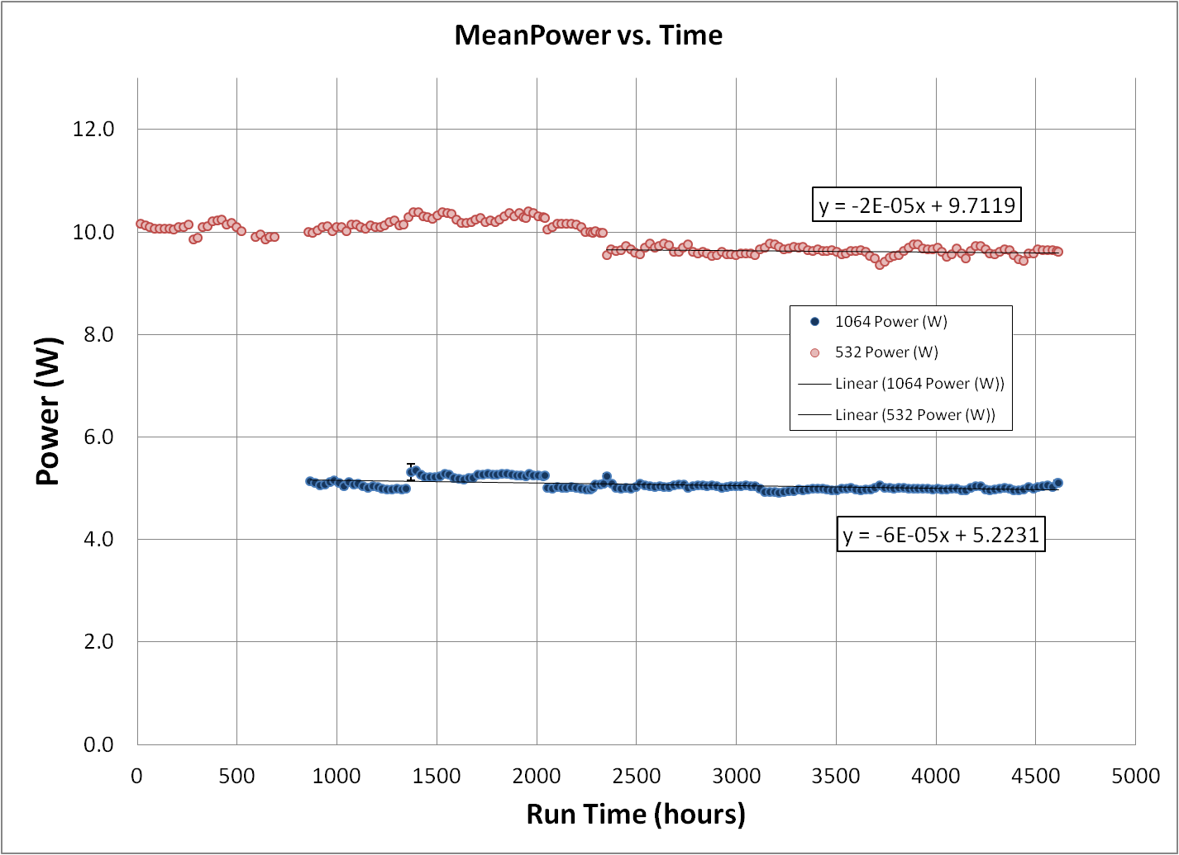
Brassboard MOPA 1 20kHz 532nm and 1064nm
532 nm shot count equivalent of 9200 hours at 10 kHz demonstrates corrective actions have mitigated 532 nm degradation
Current 532 nm power trend corresponds to a 10 kHz decay rate of < 2%/yr
Degradation rate supports the mission lifetime requirement

Slide 35
Lifetest Summary
Brassboard Oscillator #1 : 11,500 hours
  Pulse energy recovered to ~200 µJ after chiller replacement
  Qualitative linkage between high humidity and lower pulse energy is being investigated
BB MOPA #1 → 9600 1 µm MOPA raw hours
  Exhibited faster than expected 532 nm fall off – RCCA activity completed
  Corrective actions have improved 532 nm degradation rate
  System converted to 20 kHz repetition rate, similar optical fluences as the flight laser design
  1 µm MOPA has equivalent to 13,700 hours at 10 kHz → 1/2 of mission life → > 490 billion shots
    1 µm degradation < 5%
  532 nm 10 kHz equivalent hours is 9,200 hours → >330 billion shots
    < 5% degradation
nLight Pump Modules : 15,800 hours
  Fibertek life testing shows < 2% degradation per year on 4 modules
    Exceeds mission system level requirement

Slide 36
Reliability Analysis Definitions
Failure Modes Effects and Criticality Analysis (FMECA)
  Identifies all known failure modes, their underlying mechanisms, and their effect on the laser transmitter, instrument, and mission
  Criticality analysis includes estimates for each failure mode/mechanism of
    Likelihood X severity X detection/prevention value = Risk Priority Number (RPN)
    Each estimated value input can range from one to five (RPN = 1 to 125) where the higher values are worse
Fault Tree Analysis (FTA)
  Identify all of the paths (events) that could potentially occur that will lead to a particular failure mode
  Provide an estimate of the likelihood of one event path vs. another occurring
The FMECA and FTA each took into account failure modes of the laser transmitter optical system, electrical system, and housing
Two types of failures were considered: degradation and catastrophic
Notes:
36

Slide 37
Summary
FMECA
  One failure was identified whose failure has a high severity
    Loss of a particular beam expanding lens would cause the laser output beam to converge, possibly damaging optics in the ATLAS instrument external to the laser housing
    Additional simulation and measurement are necessary to burn down the risk
  Although pump modules have a moderate risk of failure, the overall risk of any specific failure mechanism is still low
Fault Tree Analysis
  The FTA failure rates are consistent with the predicted reliability
  In the optical train, each passive optical component is a single point of failure, but each failure mechanism is very low risk
  While the Diode Power Board contains several functions that are not single points of failure, all other functions that effect the performance of the laser transmitter are single points of failure
Notes:
37

Slide 38
Estimate of Transmitter Reliability
Required Life = 3 yr + 60 days + 1000 h = 3.3 years = 28,720 h ≈ 3 x 10⁴ h
Predicted transmitter reliability meets reliability budget

Slide 39
ATLAS LASER TRL-6
Definition Summary
Vibration testing in a relevant environment simulating space operation
  TRL-6 testing of Engineering Design Unit #3 (EDU-3) focused on GEVS proto-flight level random vibration testing
Thermal vacuum testing in a relevant environment simulating space operation
  Survival & operational TVAC performed per CERD on EDU-3
Component level radiation hardness verification
  Relies heavily on heritage
  Verified primarily by analysis
  Limited testing of some optical components
Focus was on laser technology
  EMI/EMC not required
  If electronics are not at TRL 6 or are an integral part of the opto-mechanical prototype then they should be included in the testing
Lifetime requirement will be demonstrated through a combination of relevant testing and analysis

Slide 40
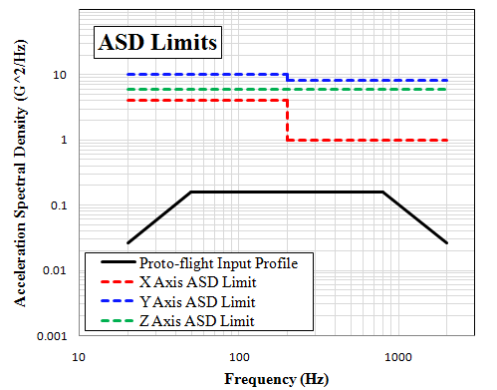
Random Vibration Test Levels
GEVS proto-flight random vibration levels are severe
  14 grms
  High content out to 800 Hz
Use allowed notching
  Shaker tables can induce artificially high loads into test articles at mechanical resonances
  Notching avoids artificial test failures & damage to test article.
  Acceleration/force limiting has become common practice.
  Force limiting vibration tests conducted routinely at JPL and other NASA centers.
Notching response limits follow guidelines in NASA-HDBK-7004B.
Input profile is automatically notched if the ASD response limit is surpassed at the diode wall accelerometer.

Slide 41
GRMS Response Summary
Worst Case Axis
 | Response Limiting (G²/Hz)
Axis | Scheme A
X | 4.0 (20-200 Hz), 1.0 (200-2000 Hz)
 | Response Limiting (G²/Hz)
Axis | Scheme A
Y | 10.0 (20-200 Hz), 8.0 (200-2000 Hz)
 | Response Limiting (G²/Hz)
Axis | Scheme A
Z | 6.0 (20-2000 Hz)
 |  | X Axis GRMS Summary 05/23/12
 |  | Diode |  |  | OSC |  |  | Control Channel
Random Vibration Test | Reference | X Resp. | Y Resp. | Z Resp. | X Resp. | Y Resp. | Z Resp. | X Resp.
Low Level Pre | 0.70 | 2.03 | 0.37 | 2.19 | 2.14 | 0.26 | 2.92 | 0.73
Proto-Flight -12dB | 3.55 | 4.05 | 1.33 | 5.50 | 4.17 | 0.90 | 7.56 | 3.65
Proto-Flight -6dB | 7.09 | 7.56 | 1.73 | 6.35 | 5.10 | 1.15 | 8.63 | 7.25
Proto-Flight Full | 14.14 | 13.82 | 7.98 | 18.89 | 15.03 | 3.82 | 26.12 | 14.32
Low Level Post | 0.70 | 2.08 | 0.39 | 2.29 | 2.14 | 0.11 | 3.03 | 0.74
 |  | Y Axis GRMS Summary 05/11/12
 |  | Diode |  |  | OSC |  |  | Control Channel
Random Vibration Test | Reference | X Resp. | Y Resp. | Z Resp. | X Resp. | Y Resp. | Z Resp. | Y Resp.
Low Level Pre | 0.70 | 0.50 | 3.81 | 0.83 | 0.62 | 1.69 | 1.17 | 0.73
Proto-Flight -12dB | 3.55 | 2.44 | 6.22 | 3.40 | 2.72 | 5.27 | 4.80 | 3.62
Proto-Flight -6dB | 7.09 | 4.23 | 12.23 | 6.11 | 5.05 | 9.84 | 8.68 | 7.25
Proto-Flight Full | 14.14 | 4.60 | 22.01 | 7.86 | 5.88 | 12.30 | 11.18 | 14.39
Low Level Post | 0.70 | 0.48 | 3.63 | 0.76 | 0.61 | 1.62 | 1.08 | 0.73
 |  | Z Axis GRMS Summary 05/17/12
 |  | Diode |  |  | OSC |  |  | Control Channel
Random Vibration Test | Reference | X Resp. | Y Resp. | Z Resp. | X Resp. | Y Resp. | Z Resp. | Z Resp.
Low Level Pre | 0.70 | 0.15 | 0.08 | 1.18 | 0.17 | 0.05 | 0.99 | 0.72
Proto-Flight -12dB | 3.55 | 0.91 | 0.44 | 5.00 | 1.07 | 0.35 | 4.56 | 3.56
Proto-Flight -6dB | 7.09 | 1.78 | 0.93 | 10.10 | 2.07 | 0.73 | 9.04 | 7.10
Proto-Flight Full | 14.14 | 2.84 | 1.85 | 20.32 | 3.24 | 1.47 | 15.52 | 14.27
Low Level Post | 0.70 | 0.15 | 0.11 | 1.22 | 0.17 | 0.06 | 1.02 | 0.71
Worst case loads in all 3-axis were below maximum levels, demonstrating the rigid box design with mounting flexures adequately attenuates vibration responses.

Slide 42
Laser Performance Summary
Post Vibration
ü
ü
ü
ü
ü
ü
ü
ü
ü
ü
ü
ü
EDU-3 passed all requirements during all phases of vibration testing

Slide 43
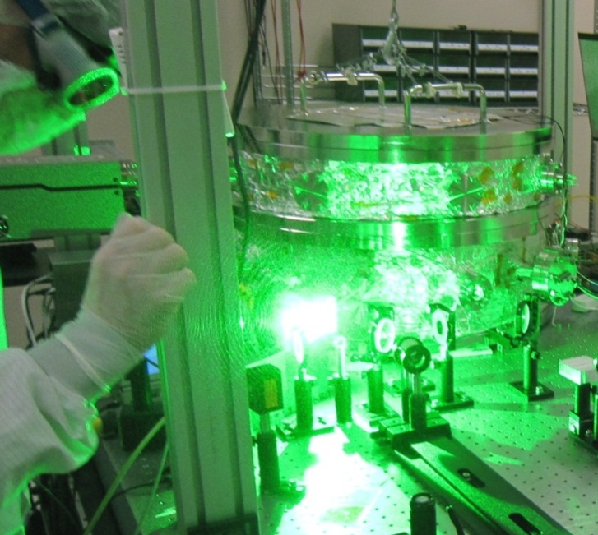
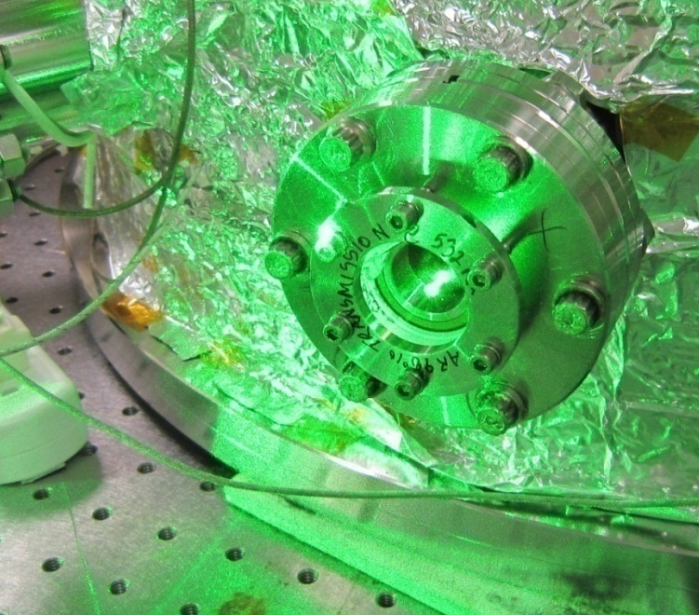
Edu-3 Thermal VACUUM Testing

Slide 44
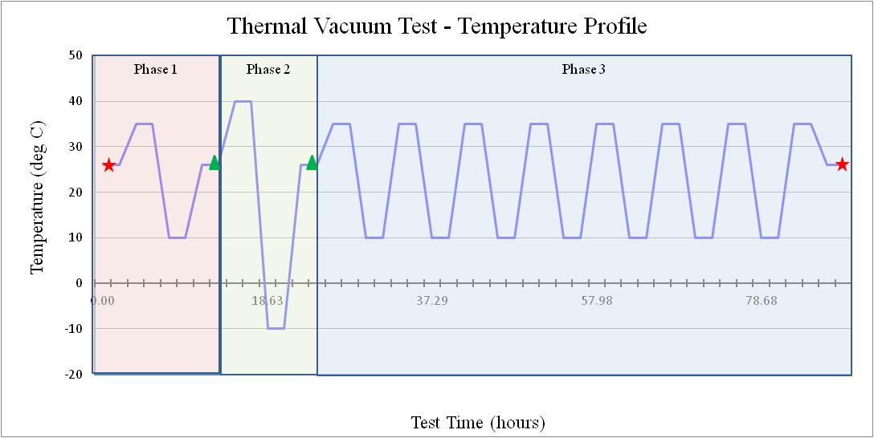

TVAC as-Run Profile
Total of 9.5 thermal cycles (1 survival + 8.5 operational)
  Additional operational thermal cycle was added to compensate for break in vacuum during the 1st operational cycle
Laser Tx is only required to operate/meet specification over +/- 1 °C centered around the nominal operating temperature

Slide 45
Laser Performance Summary Post TVAC
ü
ü
ü
ü
ü
ü
ü
ü
ü
ü
ü
ü
EDU-3 passed all requirements during all phases of TVAC testing.

Slide 46
Radiation Assessment
Benign radiation environment
  2x mission does = 2.8 kRad
Majority of the optical component are heritage glass (fused silica)
Analysis and testing of non-standard components is under way
  To date analysis and testing results all show radiation effects are low risk
Functioning oscillator was irradiated as a system level demonstration
  Oscillator contains the most of the non-standard optical components
  Oscillator is very sensitive to changes in optical losses
  Contained: Nd:YVO4 slab, RTP Q-Switch, Volume Bragg Grating
Gamma irradiated with CO⁶⁰
  18 Rad/min total does of 3.2 kRad
  Performance tested within 2 hours of irradiation to minimize annealing effects
Output power pre and post irradiation was within measurement uncertainty (5%)
  No change in static hold-off
Power (W)
Before | After
1.136 ± 0.007 | 1.168 ± 0.014

Slide 47
ICESat-2 Flight Laser Status
A third flight-like engineering has been built and successfully tested to GEVS proto-flight level
  Required to validate TRL-6 design
A second full flight configuration brassboard MOPA has been built, tested and shown to achieve all flight requirements with margin
  37% system level optical to optical efficiency
The final flight design has been completed and procurement of flight parts is well underway
Ongoing lifetime testing of multiple units supports 3 year mission lifetime projection
  Brassboard Oscillator #1
  Brassboard MOPA #2
  Engineering Design Unit #2
  16 diode pump modules
Laser Critical Design Assessment on Friday, Oct. 19

